Slide 1
Introduction to Python Classes and Objects
Mubashir Ali
m.ali.16@bham.ac.uk

Slide 2
Learning Outcomes
By the end of this lesson, you should be able to:
What Object-Oriented Programming (OOP) is
The concept of "programming paradigm.”
The advantages of Object-Oriented Programming.
What are Classes and Objects?
Defining a Class
Creating Objects (Instances)

Slide 3
Learning Outcomes
7. Instance Methods
8. Constructors (init method)
9. The Self
10. Class Attributes vs. Instance Attributes
11. Class with constructor and instance method

Slide 4
Object Oriented Programming
A programming paradigm that organizes software design around objects.
Objects will be the main elements of this programming paradigm.
But what is programming paradigm ?
A programming paradigm is an approach that we use to solve problems with our code.
A style or "way" of programming.
There are many programming paradigms

Slide 5
Programming Paradigms
Procedural Programming: ﻿writing programs made of functions that perform specific tasks
﻿Procedures (functions) typically operate on data items that are separate from the procedures
﻿Data items commonly passed from one procedure to another
﻿Focus: to create procedures that operate on the program’s data
Object-Oriented: ﻿combining data and functionality and wrap it inside what is called an object.

Slide 6
Object-Oriented Programming
Object-oriented programming (OOP) ﻿involves programming using objects.
﻿An object represents an entity in the real world that can be distinctly identified. For example, a student, a desk, a circle, a button, and even a loan can all be viewed as objects.
An object has a unique identity, state, and behaviors.
Identity – Unique Name
State – data fields (also known as properties)
Behavior – a set of methods

Slide 7
Advantages of OOP
Modularity
OOP promotes modularity by breaking down complex systems into smaller, manageable modules (classes and objects).
Reusability
The classes and objects can be reused in other parts of the program or in different programs, enhancing code reusability and reducing redundancy.
Maintenance and Scalability
OOP code is easier to maintain, as changes can be localized to specific classes or objects. This helps in enhancing scalability and reducing the likelihood of introducing errors or bugs.

Slide 8
Advantages of OOP
Collaborative Development:
OOP promotes OOP allows for collaborative development, as different programmers can work on different classes or objects simultaneously, improving productivity and enabling larger software projects to be developed efficiently.
Improved Problem Solving
OOP allows to break down complex problems into smaller, more manageable components, leading to a more organized and structured approach to problem-solving.
Ease of Testing and Debugging:
OOP code is generally easier to test and debug due to its modularity.

Slide 9
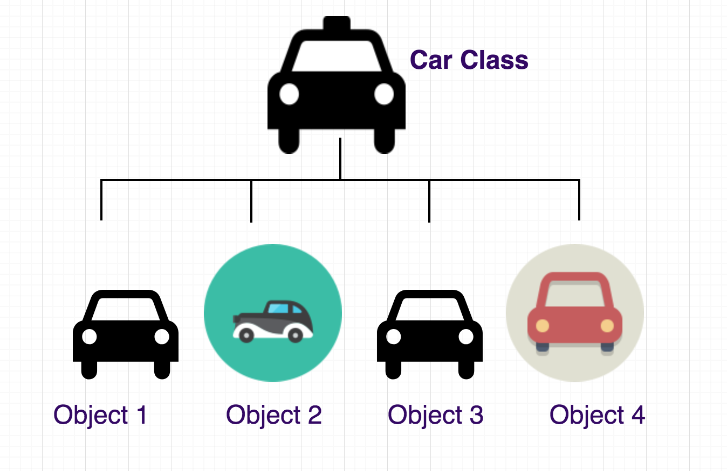
What is Class?
A class is a blueprint for creating objects.
It is simply a template that we construct object from it.
It defines the properties (attributes) and behaviors (methods) that objects of that class will have.

Slide 10
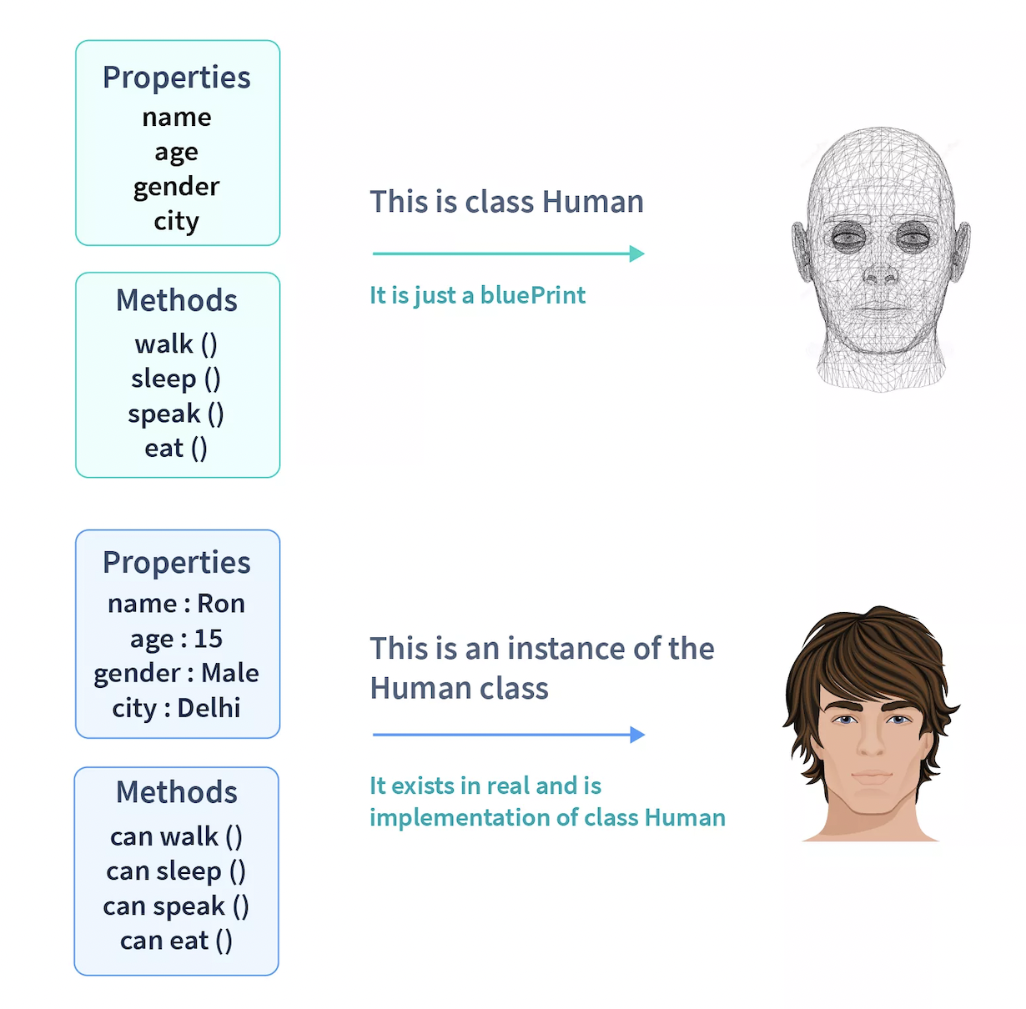
OOP - Class

Slide 11
Class
Why classes act like blueprints to create objects?
Why classes are important in Object-Oriented Programming?
How to identify classes in a problem statement?
How to define a class in Python?

Slide 12
Class
They act like “blueprints” that describe the state and behaviour of a real-world object.
They are used to represent real-world objects or entities relevant to the context of a program.
For example, houses, bank accounts, employees, clients, cars, products.

Slide 13
Key Components of a Class
Class Attributes
Variable that store data
Methods
Functions that perform actions on the data
Object(Instance)
A specific instance created from a class

Slide 14
Guidelines of a class
Class names are typically nouns. They should start with an uppercase letter. For example: House, Human, Dog, Account etc.
If the name has more than one word, each word should be capitalized following the PascalCase naming convention.
SavingAccount, HelloWorld etc.

Slide 15
Objects
An object is a combination of variables (also called attributes or instance variables or object variables) and behaviors (i.e., functions, which are referred to as methods in the object context)
Called an instance of a class.
In Python everything is an Object.

Slide 16
How to Identify Classes and Objects
We start with an initial description of the problem, and from that description, we have to identify
The objects that will be relevant for our program or system.
You will write down a written description of all the elements of the problem in your own words, and then you will have to extract the elements that are relevant to the system or program.
This is what we usually call a problem statement.

Slide 17
Problem statement
Our store serves fast food. The items sold include pizza, burgers and hot dogs. We also sell soda, water and French fries. Clients may choose to buy one or more items. If they choose to buy more than one item, then they receive a special discount of 20 percent. The store has five employees.

Slide 18
Problem statement
Our store serves fast food. The items sold include pizza, burgers and hot dogs. We also sell soda, water and French fries. Clients may choose to buy one or more items. If they choose to buy more than one item, then they receive a special discount of 20 percent. The store has five employees.

Slide 19
Problem statement
Our store serves fast food. The items sold include pizza, burgers and hot dogs. We also sell soda, water and French fries. Clients may choose to buy one or more items. If they choose to buy more than one item, then they receive a special discount of 20 percent. The store has five employees.

Slide 20
Questions
Is the term that you selected needed for the scope of the project?
Does the term represent an example of a class ?
Is this class important for the program that we are creating?

Slide 21
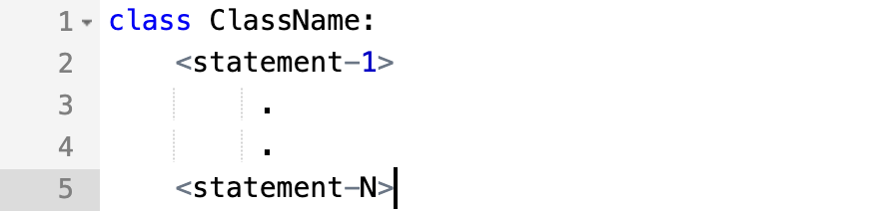
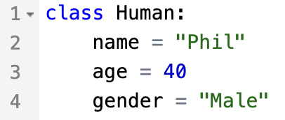
Defining A Class
Classes in Python can be defined by the keyword class, which is followed by the name of the class and a colon.
﻿
Indented code below the class definition is considered part of the class body.

Slide 22
Creating an Object of Class
Creating an object from a class is called instantiating an object.
As soon as an object is instantiated, memory is allocated to them.
Format:
Example:

Slide 23

A class with no data and no methods
A very simple class. The objects hold no data and have no methods
'pass' is commonly used as placeholders, in the place of code whose implementation we may skip for the time being. "pass" allows us to run the code without throwing an error in Python.

Slide 24

But classes have attributes and methods
ATTRIBUTES
Name:
Phone:
Email:
Purchases:
BEHAVIORS
Open account
Buy investments
Sell investments
Close account

Slide 25
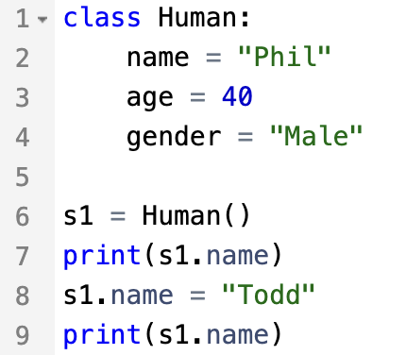
Accessing and changing class attributes
Accessing class attribute
name = “Phill”
Changing class attribute
name = “Todd”

Slide 26
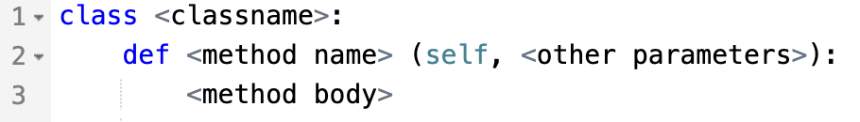
Defining class methods – instance methods
An instance method is a function defined within a class that can only be called from instances of that class.
Format:
Unlike functions, every method of a class must have the self parameter (more on this later)

Slide 27
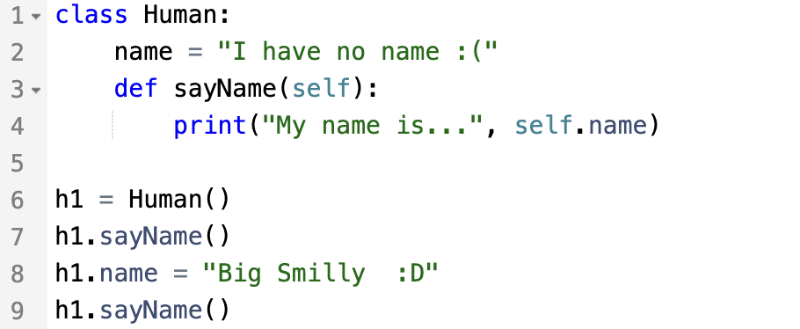
Defining class methods
My name is... I have no name :(
My name is... Big Smilly :D

Slide 28
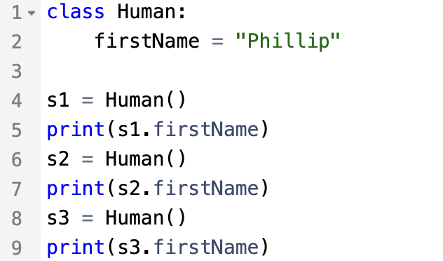
Creating multiple Object of a Class
After defining a class, you can create any number of objects out of it
But all of the above humans have the same name!
How can we have human objects with different names?
name = “Phillip”
name = “Phillip”
name = “Phillip”

Slide 29
Class Constructor __init__ method
All classes in Python have a function called __init__(), which is always executed when the class is being initiated (i.e., an object out of it is created).
The properties that all Human class objects must have, are defined in a __init__() method.
You can use the __init__() function to assign values to the data members when an object is created for the class.

Slide 30
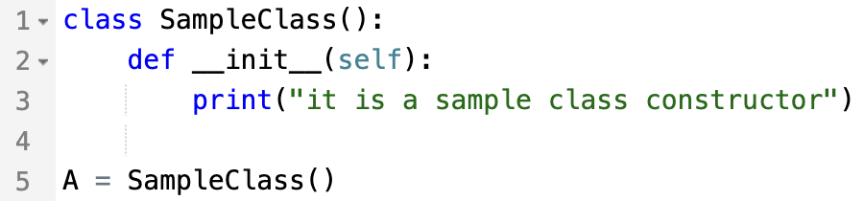
Class Constructor __init__ method

Slide 31
Constructors in Python
Parameterized Constructor
Non-Parameterized Constructor
Default constructor

Slide 32
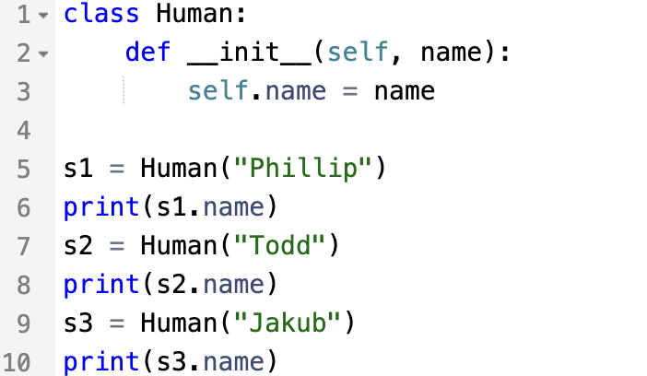
How to define __init__() in Human class:
The constructor should always have the keyword self as its first parameter
Phillip
Todd
Jakub

Slide 33
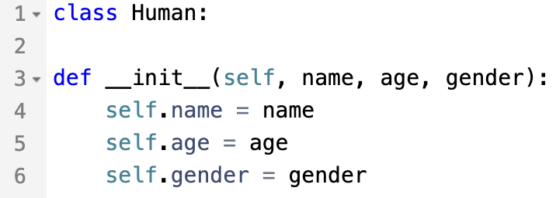
How to define __init__() in Human class:
Every attribute in a class should be always prefaced with self upon accessing it

Slide 34
The self
﻿The first argument of every method is a reference to the current instance of the class.
﻿By convention, we name this argument self.
In __init__, self refers to the object ﻿currently being created; ﻿so, in other class methods, it refers to the instance whose method was called.
﻿Similar to the keyword this in Java or C++.
﻿But Python uses self more often than Java uses this.

Slide 35
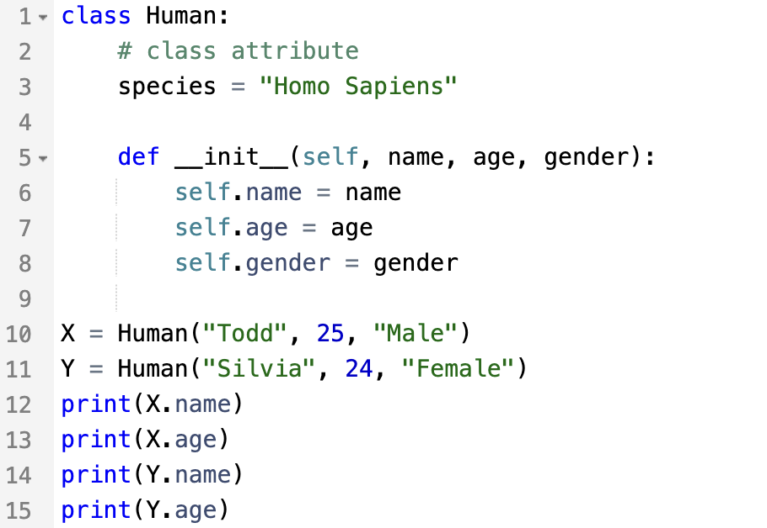
How to access values using objects
Todd
25
Silvia
24

Slide 36
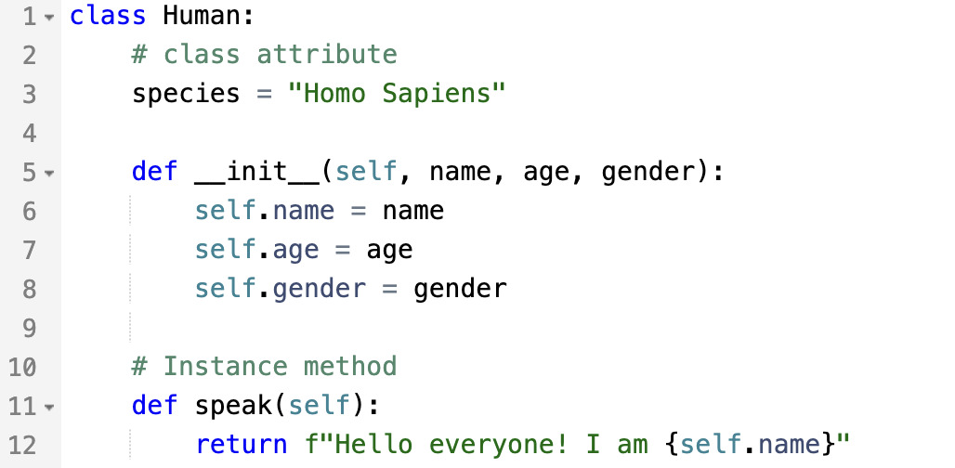
Human class with __init__ and instance methods

Slide 37
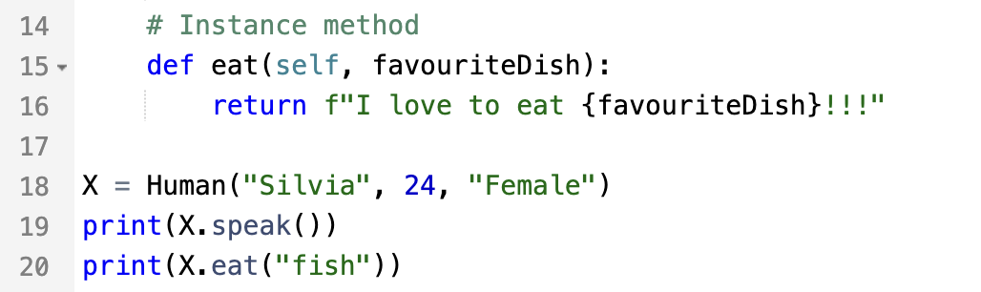
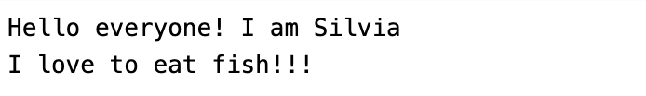
Human class with __init__ and instance methods

